Slide 1
Members Seminar - Sustainability
12th May 2021

Slide 2
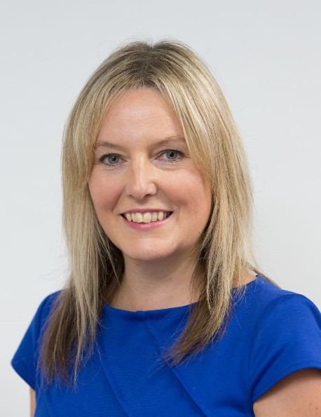
About me
Length of service:
Why sustainability?
13 years at Broadland, 9 years as a Director
I am committed to supporting change within Broadland and with our customers, to safeguard the future. We all have a responsibility to recognise ways that we can live and work more sustainably.
Responsible for:
Repairs and Planned Works
Asset Management
Facilities and Services
Health and Safety
Estate Services
Cleaning Services
Neighbourhood Teams
Recognition:
Name: Louise Archer
Role: Executive Asset Director
Louise received an award for Sustainable Leadership

Slide 3
Agenda
What is sustainability
What is zero carbon
What are our existing targets
What are the targets put in place by the government
What have we done so far
Fuel poverty / zero carbon
Future technologies
Building a plan to zero carbon
Next steps
Notes:
Sustainability is a wide subject, so covering some background and then mainly concentrating on existing homes. 14% of carbon from homes, plus estimated that 2.1millin of housing association homes will need to be retrofitted by 2050 to meet government targets

Slide 4
Jargon Buster

Slide 5
What is Sustainability
Sustainability: using our natural resources responsibly, so we can meet our needs today, but also safeguard those resources for future generations.

Slide 6
What is ESG

Slide 7
What is Carbon
Carbon is bad for the environment because carbon emissions actually hold heat in the atmosphere. So, the more fossil fuels and such are burned, the quicker the temperature should rise.
Carbon is mandatory to survive as well, so don’t only see the bad affects of carbon. All plants and animals need it to survive.

Slide 8
Zero Carbon and Carbon Neutral / Net Zero Carbon
Zero Carbon: no carbon emissions are being produced from a product or service
(e.g. zero-carbon electricity could be provided by 100% renewable energy supplier)
Carbon Neutral / Net Zero Carbon: while some emissions are being generated, these emissions are being offset, making overall emissions zero
(such as buying only renewable energy or investing in emissions reduction projects)

Slide 9
What is Fuel Poverty
Fuel Poverty: having to choose between eating and heating
Important to balance the need to reach zero carbon, with the possible implications on our tenants, particularly the fuel poor.
We need to ensure that the changes we are bringing in will benefit all our tenants by adopting a careful, targeted approach and having accurate data.

Slide 10
Targets – Government
10-point plan for a Green Industrial Revolution
(UK Gov. November 2020)
UK to aim for net zero on all green house gases by 2050 (Committee of Climate Change 2019)
Keep global warming under 2 degrees
(Paris Agreement 2016)

Slide 11
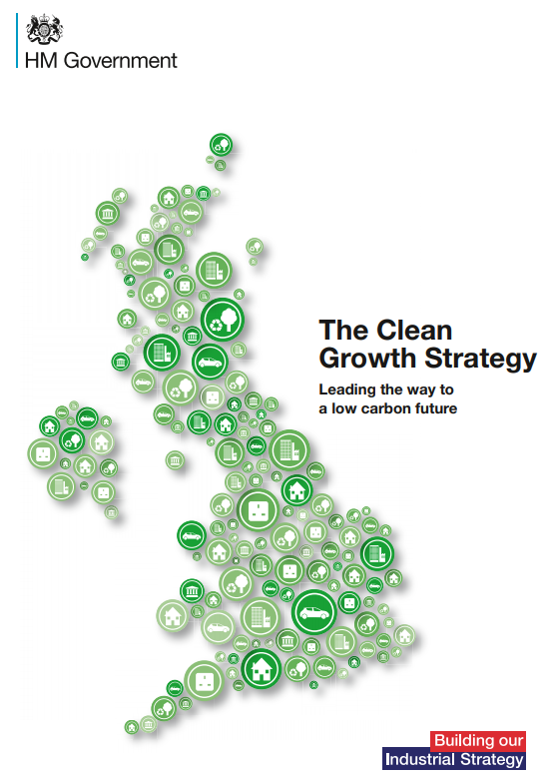
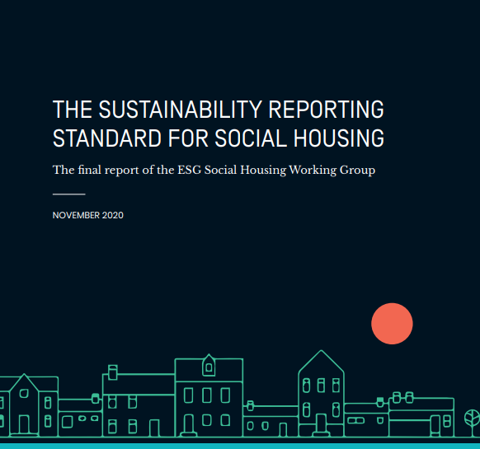
Targets – Government
Clean Growth Strategy
All fuel poor homes to have an EPC C by 2030.
(UK Gov. October 2017)
Sustainability Reporting Standard for Social Housing
A voluntary reporting framework.
Housing is responsible for 14% of UK emissions.
(The ESG Social Housing Working Group November 2020)

Slide 12
Targets – Social Housing (Existing Homes)
Interim Targets = To reduce as many fuel poor households as reasonably practicable.
2020
Minimum of
Band E*
2025
Minimum of
Band D*
2030
Minimum of
Band C*
* Where practical, cost effective and affordable

Slide 13
Targets - New Build Homes
Building Regulation Changes
75% to 85% reduction in carbon by 2025
Future Homes Standard 2025
Focusing on insulation and capacity for heat pumps
No Gas Heating
In new build homes from 2025
Further changes to Building Regulations planned following a 2nd consultation

Slide 14
What have we done so far….

Slide 15
Environmental Champions
Group of staff from all aspects of the organisation
Ambassadors for sustainability
Each champion is set a sustainable objective as part of their annual appraisal
Focus on small changes in everyday behaviour
Run events for staff and tenants to promote awareness
We are working to recruit Tenant Environmental Champions

Slide 16
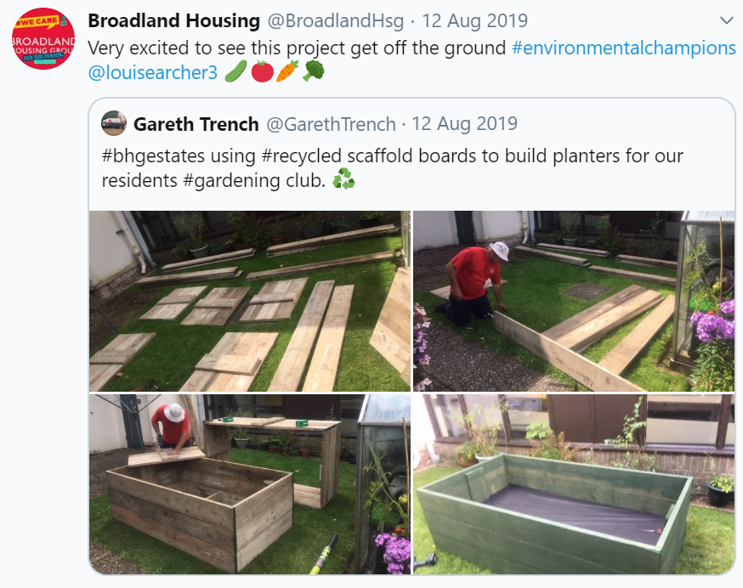
Website, Social Media, Newsletter

Slide 17
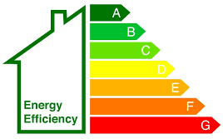
Targets - Broadland
100% of our office waste diverted from landfill by 2050
45% increased likelihood of recycling by our tenants 2050
Average SAP of 86 by 2050
Long-term Sustainability Targets
100% responsibly sourced materials by 2050
50% increase in car sharing by 2030
2.6kgs CO2 per home managed per year by 2050
Notes:
Forms one of our Corporate Strategy strands
Set 3 years ago – before most of the net zero carbon interim targets had been set. Based on the 2050 end goal

Slide 18
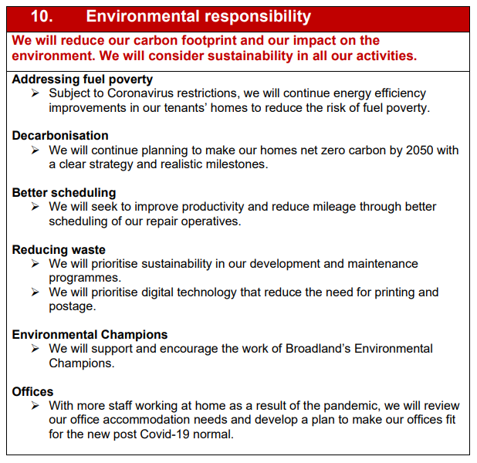
Strategic Performance Measures

Slide 19
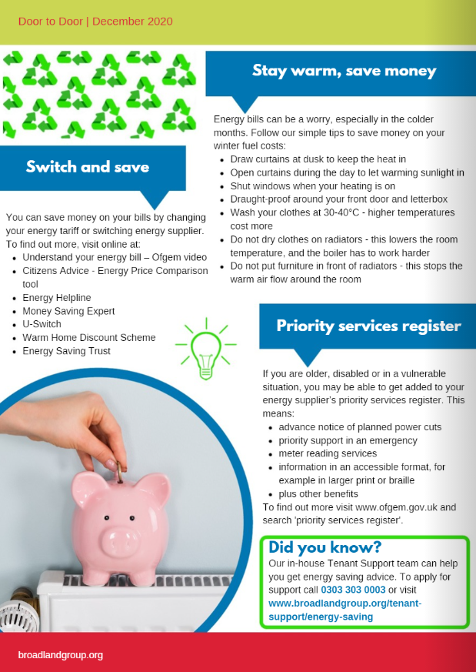
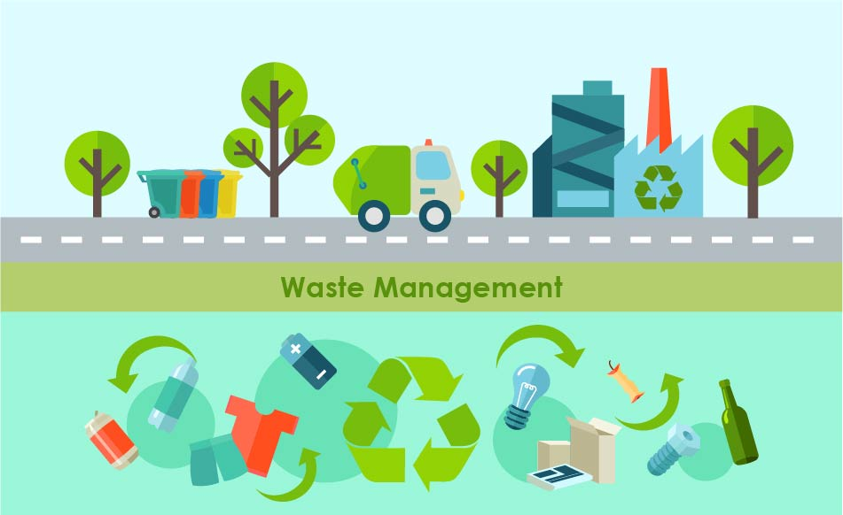
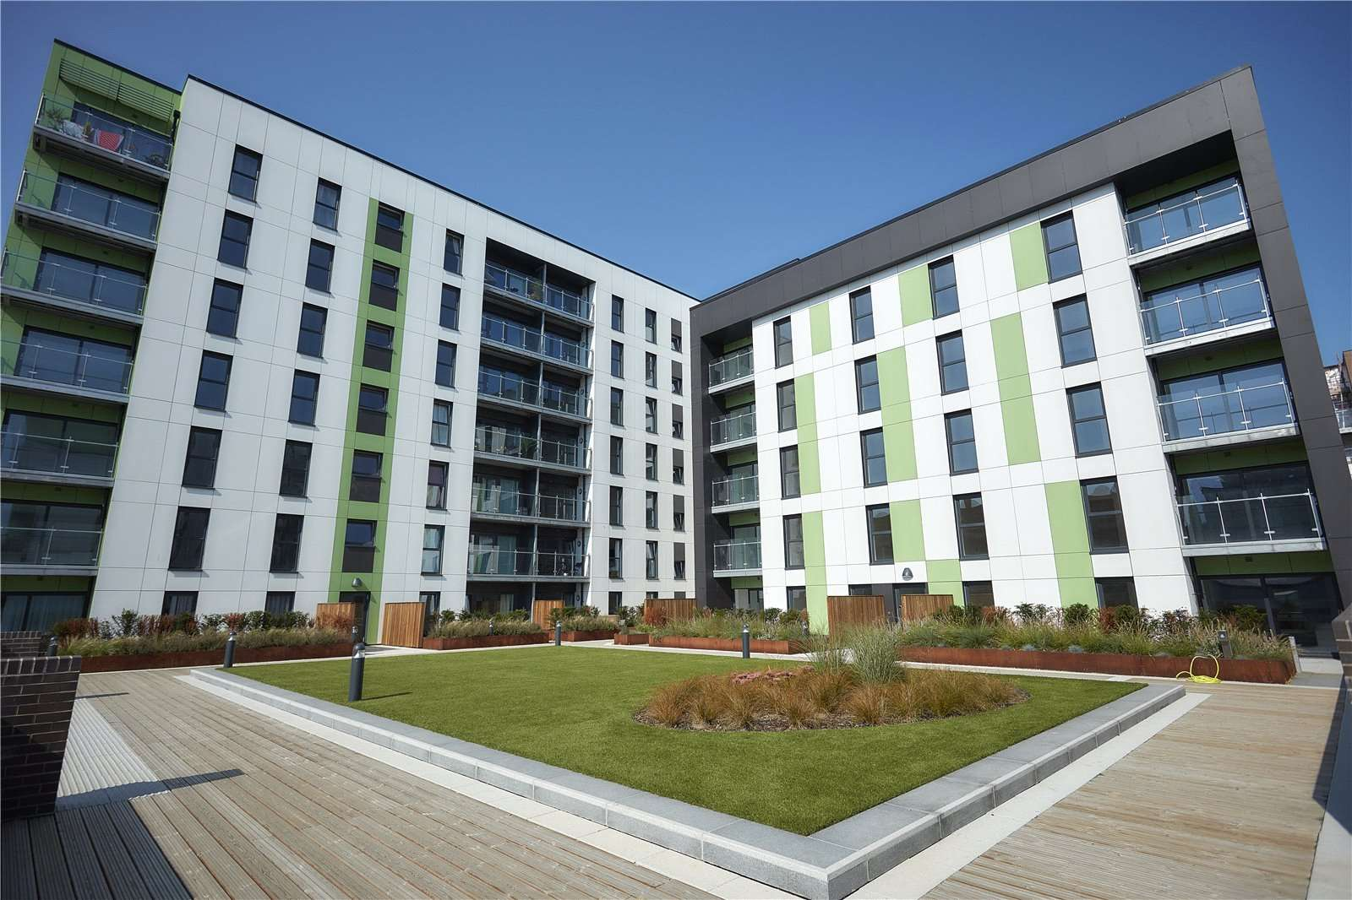
Sustainability Assessment
SHIFT Assessment = Sustainable Homes Index For Tomorrow
(the sustainability standard for housing)
Annual assessment undertaken to measure how sustainably Broadland operates
Covers key factors including:
Notes:
Carbon emissions
Waste management
EPC rating of our homes
Sustainability of our new builds
Helping tenants to live more sustainably

Slide 20
Sustainability Assessment
2012
2014
2016
2018
2020
Our SHIFT Journey
Notes:
Carbon emissions
Waste management
EPC rating of our homes
Sustainability of our new builds
Helping tenants to live more sustainably

Slide 21
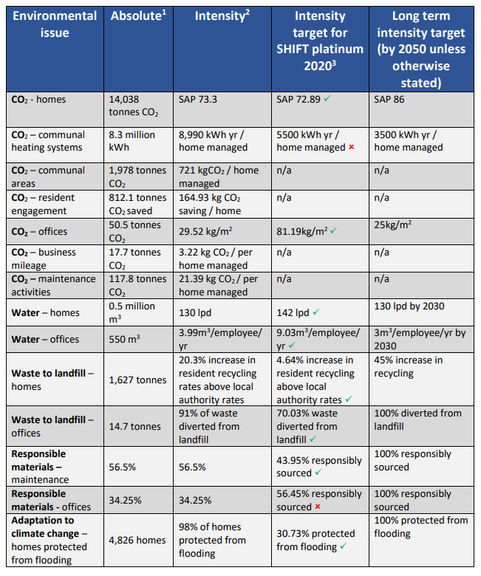
Sustainability Assessment 2020
Notes:
Carbon emissions
Waste management
EPC rating of our homes
Sustainability of our new builds
Helping tenants to live more sustainably

Slide 22
Energy rating of our homes
A (92-100) | B (81-91) | C (69-80) | D (55-68) | E (39-54) | Awaiting survey
0 | 862 | 3,420 | 679 | 13 | 51
National Average SAP Rating = 65
Sector Average SAP Rating = 68.4
BHA Average SAP Rating = 73.4
SAP = Standard Assessment Procedure assesses how much energy a home will use
EPC = Energy Performance Certificate provides an energy efficiency rating for the home
Notes:
84% are at an EPC C or above. Issue with those that are hard to treat – what do we do? Eg conservation area – planning restrictions. Asking to change the timber windows and being refused

Slide 23
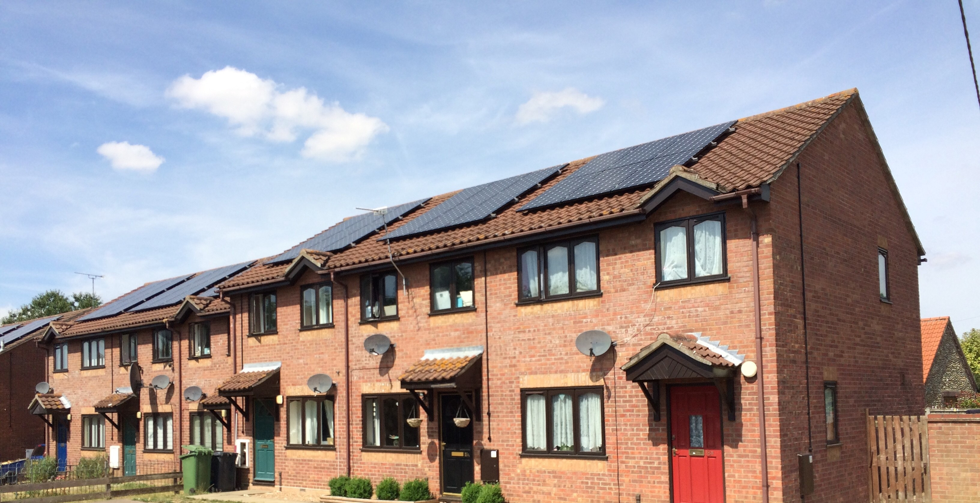
Works to existing homes
Photovoltaic panels fitted to the roofs of one of our schemes.
There are lots of different works we can undertake to improve the energy efficiency of our homes such as insulation, solar panels or new heating systems.
We continually monitor the EPC ratings of our homes so we can identify where works are most needed. Above shows the progress from 2012 to 2020.

Slide 24
CROHM (Portfolio)
CROHM = Carbon Reduction Options for Housing Managers
A system we use to map out what works are needed to reach our Net Zero targets.
The Headlines:
To achieve a minimum EPC of C for all Broadland’s Homes = £4.5 million
To achieve a minimum EPC of B for all Broadland’s Homes = £35 million

Slide 25
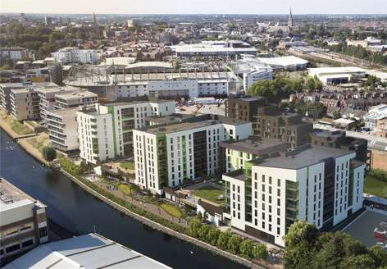
New build homes
Last year Broadland increased it’s portfolio by 273 homes.
EPC ratings were
52 = High C
62 = Low B
159 = High B
We include recycling bins in our kitchen designs
Our new scheme at Canary Quay is getting its own Car Club car
We ensure all our materials are responsibly sourced
We fit low flow showers, taps and toilets to save water
We are already using alternatives to gas, such as District Heating Systems
Notes:
In addition, putting in electric vehicle charging points. Looking at how we can change fleet in electric at the next renewal

Slide 26
Significant Challenge
The estimated cost of taking a home from EPC C to Zero Carbon is £20,000. (higher for homes in listed buildings or those in a conservation area)
Building new homes to higher environmental standards is part of the solution, but 80% of the homes we will live in in 2050 are already built.
Notes:
Some – without changes to planning, we may never be able to get to EPC C. Most cost £40,000

Slide 27
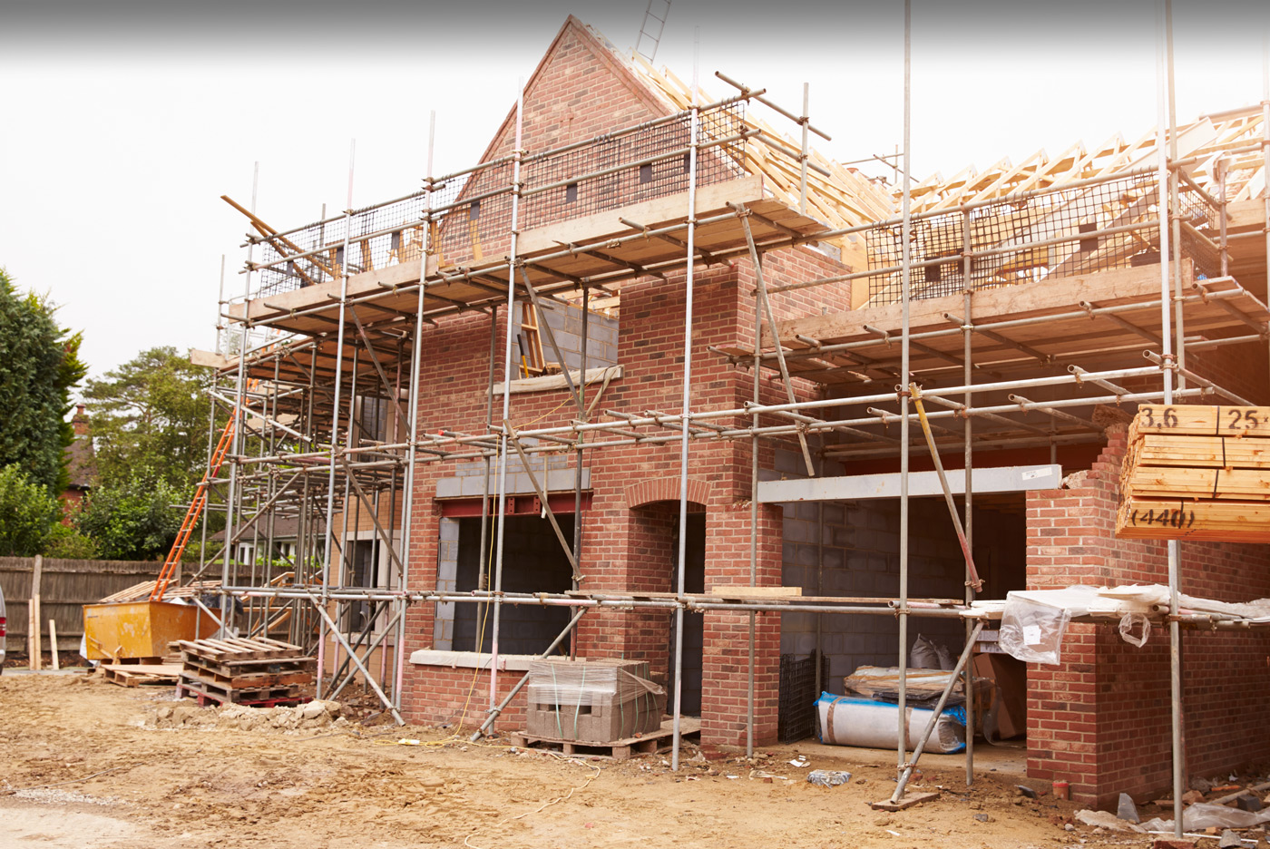
Funding
?
Greater clarity around the requirements and long-term funding is needed.
A
B
C
Balancing funding zero carbon and still achieving all our other ambitions.
Notes:
EG balancing the need to achieve the higher fire safety standards and keep on with our new build programme. Still doing our other planned replacements, such as bathrooms and kitchens

Slide 28
Funding
Funding Opportunities
Energy Company Obligation (ECO3) scheme
Social Housing Decarbonisation Fund (SHDF)
Green Homes (closed)
Notes:
Sometimes difficult to access. Examples of failed applications before. Pilots for SHDF – working with councils – have put applications in.

Slide 29
The Road to Net Zero Carbon
Housing Associations own and manage around £2.7 million homes across England. This means we need to retrofit around 2.1 million homes over the next 30 years, to become Carbon Neutral.
The NHF found that social housing outperforms other tenures and are committed to make homes greener and warmer for residents by the need to tackle climate change and fuel poverty, improve resident satisfaction, health and wellbeing and cut fuel bills for residents.

Slide 30
Building a plan to Zero Carbon
BHA is already fitting alternative heating systems in our new build homes
We are starting to map out our decarbonisation journey, consulting with specialists in this area
Working with our Board to establish what our priorities are and how to achieve them
Notes:
We have made a start on some of our long term targets, but need to focus in on what it means for our new homes (may have to retrofit later) and our existing homes and what we want to achieve and when

Slide 31
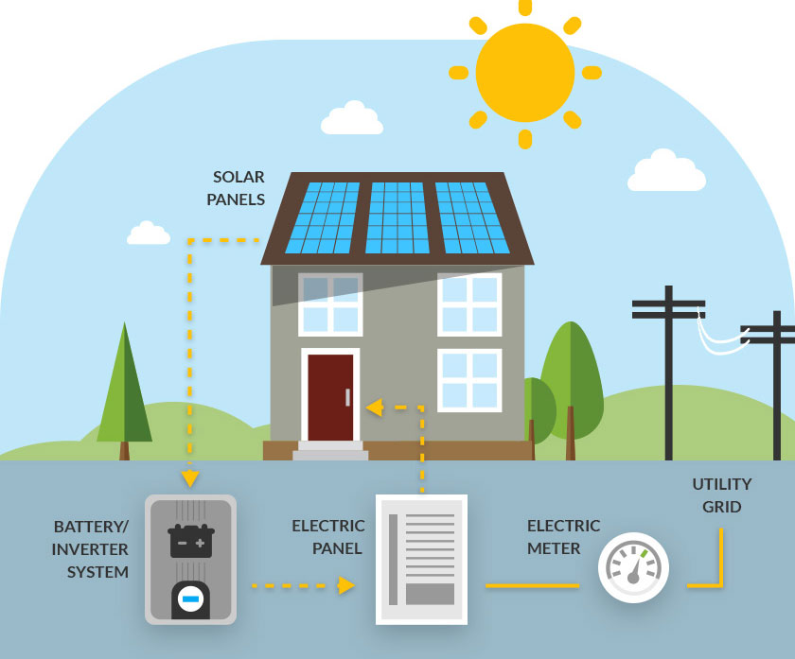
Future Technologies
Switchee Devices
Battery Storage
Decarbonisation of electricity

Slide 32
Conclusion
Social Housing is ahead of other housing
Broadland is ahead of a lot of other Social Housing Providers
However, there is a lot of work needed to reach net zero legislation by 2050, which is not that far away…….

Slide 33
Thank you!

