Slide 1
Homelessness in the UK.
May 2026
Notes:
Welcome and thank you for attending. My name is Lisa Naylor and I am Head of Built for Zero at Crisis UK. and this presentation talks about the work that Crisis Uk is doing through it’s Built for Zero work together with how Hjemløsninger (Home Solutions) in Denmark are undertaking the same methodological approach within a very different landscape both from a policy and cultural point of view and how we are working together to test and learn how our work is strengthening housing systems both locally and nationally through real-time homelessness data.

Slide 2
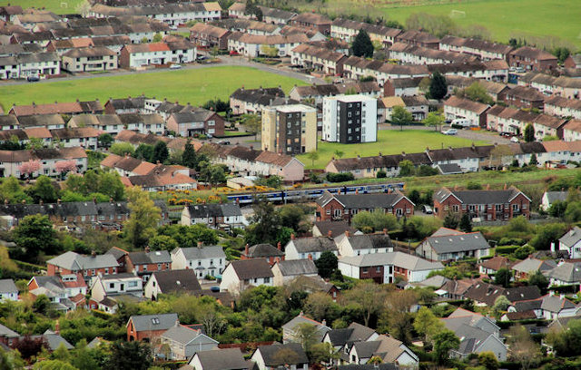
About Crisis
Crisis UK is the national charity for homeless people, dedicated to ending homelessness across England, Scotland, and Wales. We provide life-changing direct support while simultaneously campaigning for the systemic changes needed to solve the issue permanently.

Slide 3

Our mission
Relentless pursuit of a future free from homelessness through evidence-based solutions and co-production with people who have lived experience.

Slide 4
Content
The 2026 Landscape
Current market forces
Future Prognosis
Success Models
Turning the tide and building resilience

Slide 5
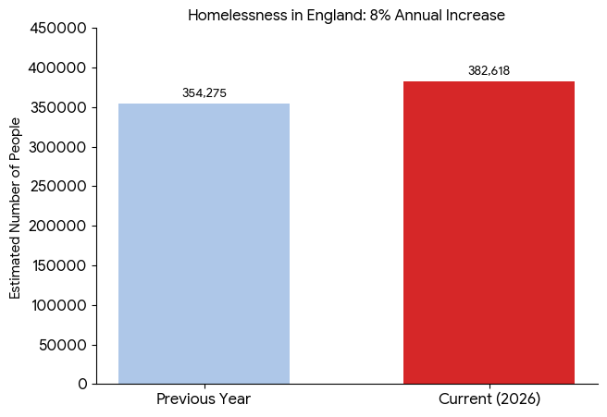
The 2026 landscape in England
Total homelessness population
Crisis defines homelessness as the lack of a home not rooflessness or lack of physical shelter.
.
An estimated 382,618 people are currently recorded as homeless in England—an 8% increase in a single year. Since 2012 the increase is 45%

Slide 6
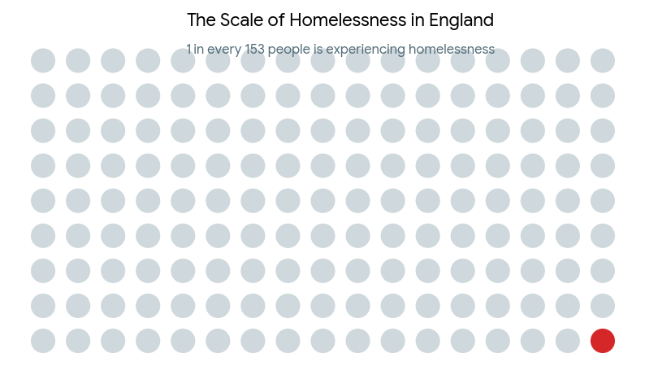
The 2026 landscape in England
Total homelessness population
This means at least 1 in every 153 people in the country is experiencing homelessness

Slide 7
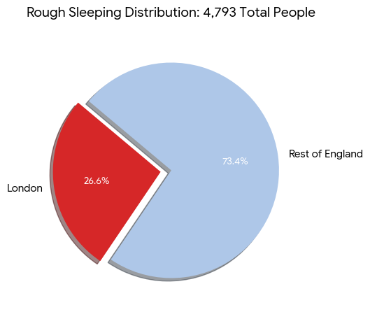
The 2026 landscape in England
Rough Sleeping
The London Factor: Over 1 in 4 (26.6%) of all people sleeping rough in England were found in London.
Record Highs: Emphasize that the total of 4,793 is a historic peak since recording began in 2010.
Single Night Snapshot: This is a "point-in-time" count, which Crisis UK often notes is likely a conservative estimate compared to the reality over an entire year.

Slide 8
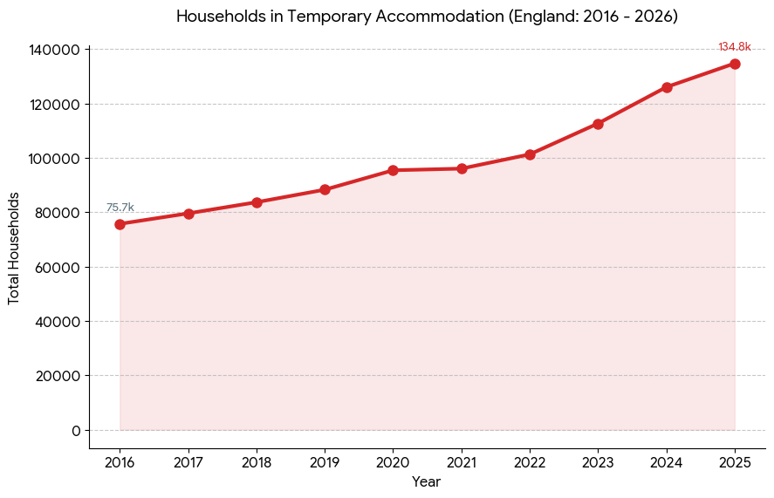
The 2026 landscape in England
Temporary Accommodation
The Decadal Shift: Between 2016 and 2026, the number of families and individuals living in TA has surged from roughly 75,000 to over 134,000.
Post-Pandemic Acceleration: While the rate was steady pre-2020, there has been a notable acceleration in the last three years due to the combined pressures of the cost-of-living crisis and private rental market instability.
Record Highs: We are currently in an unprecedented period of housing emergency, with figures consistently breaking all-time records.

Slide 9
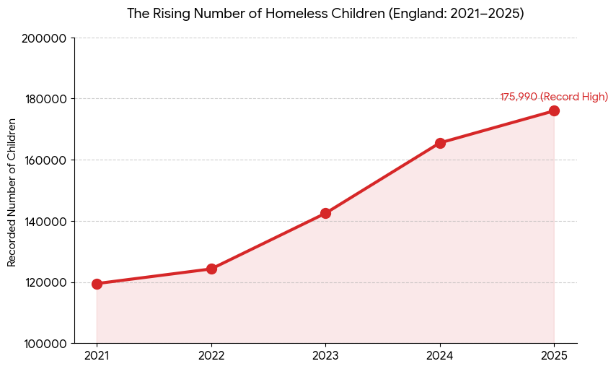
The 2026 landscape in England
Children
At least 175,990 children are currently living in emergency temporary accommodation—marking the 11th consecutive record high for this demographic
The number of homeless children is now larger than the entire population of the city of Oxford.
For many families, "temporary" is a misnomer; at least 1 in 4 households with children have been stuck in this accommodation for between two and five years.

Slide 10
Current market forces
The private rental market ‘squeeze’
The private rented sector (PRS) is currently one of the leading drivers of homelessness.
Skyrocketing Rents: Private rents in England have seen their highest annual growth since records began, often outpacing wage increases.
The "No-Fault" Eviction Factor: Section 21 notices remain a primary cause of households losing their homes. Even with pending legislative changes, the threat of sudden eviction keeps many in "hidden homelessness" (sofa-surfing).
Supply Shortage: There is a severe lack of properties available for those on low incomes or receiving benefits, as many landlords have exited the market or increased vetting requirements.

Slide 11
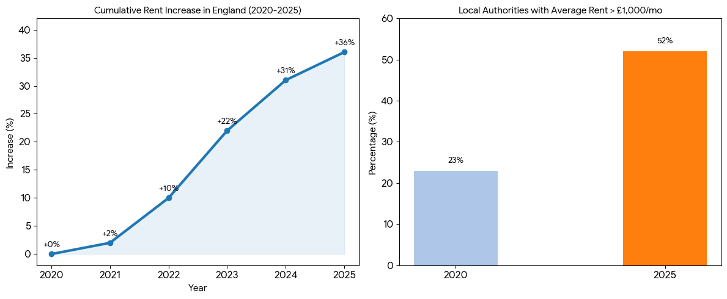
Current market forces
The private rental market ‘squeeze’

Slide 12
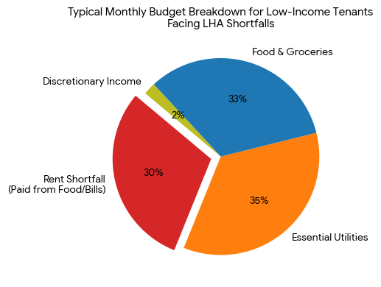
Current market forces
LHA effect on tenants
Negative side-effects
The ‘heat or eat’ dilemma
Surge in Section 21 No fault evictions
Shared accommodation trap
Homeless from hostels
DHP exhaustion

Slide 13
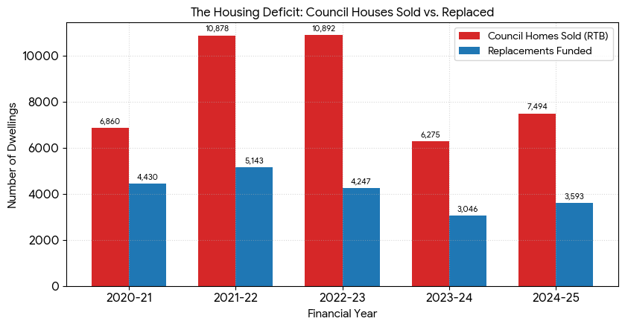
Current market forces
The Scarcity of Social Housing
The "market force" here is actually a lack of a non-market alternative.
Stagnant Social Stock: The sell-off of social homes through "Right to Buy" has not been matched by new builds, leaving over 1.2 million households on local authority waiting lists.
Dependency on Temporary Solutions: Because there are no long-term social homes available,

Slide 14
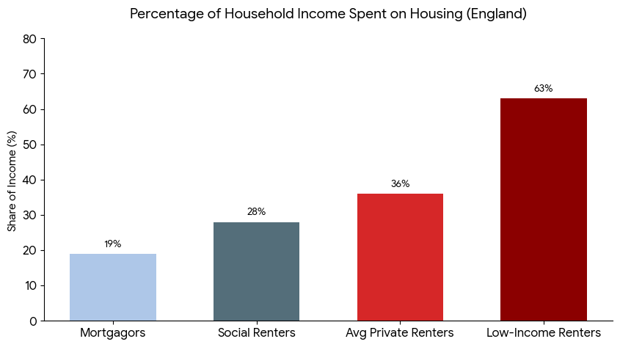
Current market forces
The Scarcity of Social Housing
The Low-Income Cliff: Private renters in the lowest income bracket face the heaviest burden, spending an average of 63% of their income on housing.
The 30% Threshold: Most economists consider housing "affordable" if it costs 30% or less of gross income. Nationally, England has been consistently above this threshold for years

Slide 15
Future Prognosis
A Continued Rise (2026–2027)
Most analysts expect homelessness numbers to reach new peaks before stabilizing:
"Core" Homelessness Projections: Recent Crisis research estimates that without drastic action, core homelessness—including rough sleeping and sofa-surfing—could rise to over 392,000 households by 2041.
The TA Backlog: The number of households in temporary accommodation is forecast to remain at record levels throughout 2026 as local councils struggle with a massive backlog and a lack of available permanent social housing.

Slide 16
Future Prognosis
Renters Rights Act and Landlord exodus
The implementation of the Renters’ Rights Act on May 1, 2026, marks a major legislative shift: The total ban on "no-fault" evictions is the single biggest factor expected to reduce the flow of people into homelessness over time.
Shrinking rental stock: Estimated projected loss of 5% of all rental properties by end of 2026
Surging sales instructions: In high demand areas homes listed for sale surged by 17.6% whilst volumes of properties listed for rent plunged by 21.7%
According to TwentyEA properties that have been actively rented in the last three years made up 15.6% of all new housing market sales instructions!

Slide 17
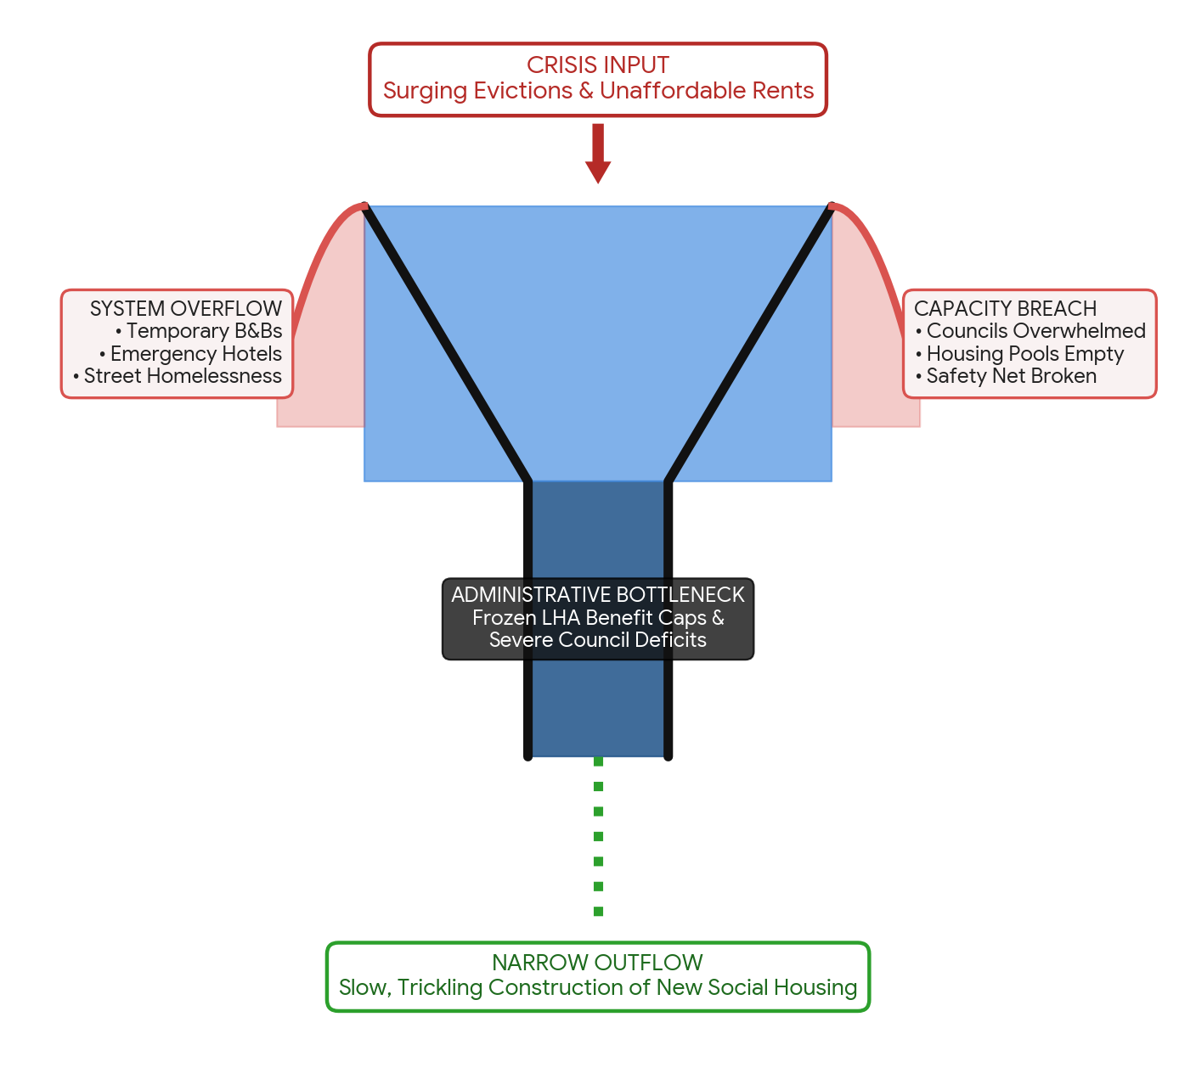
Future prognosis
Or are we already here?

Slide 18
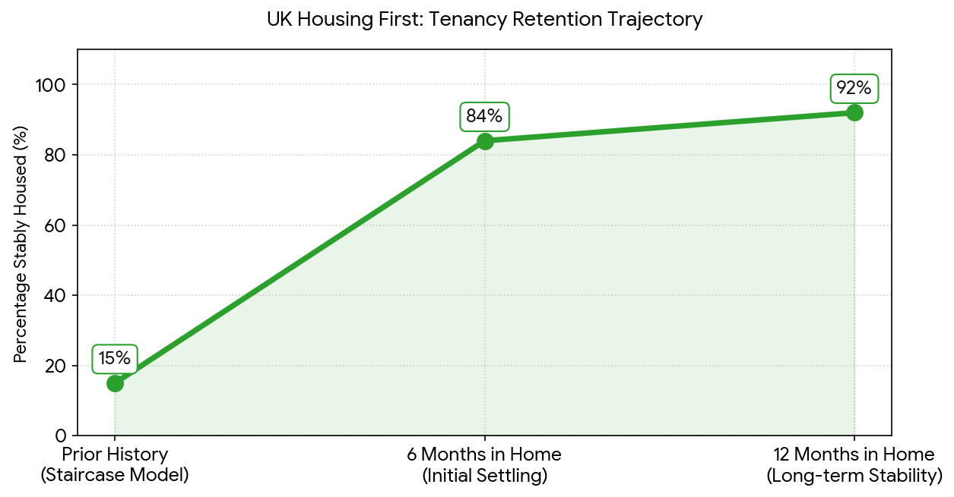
Success Models
Housing First
Familiar to us in the UK
Model for chronic and complex needs
Puts housing at the start of the journey
National pilots show sustainment rate of 80-90%
Savings across the whole system

Slide 19
Success Models
Upstream Prevention the Geelong Project
A world-renowned early intervention model launched in Geelong, Australia, that aims to stop youth homelessness before it occurs.
The project works directly within secondary schools using data-driven screening to identify at-risk youth and wrap supportive services around them and their families
This pioneering framework—known as the Community of Schools and Services (COSS) model—has been so effective that it has been globally adapted, including by the youth homelessness charity Centrepoint in England and Llamau in Wales under the "Upstream" initiative.
The project abandons traditional self-referral (waiting for a student to ask for help) and replaces it with proactive, universal screening.

Slide 20
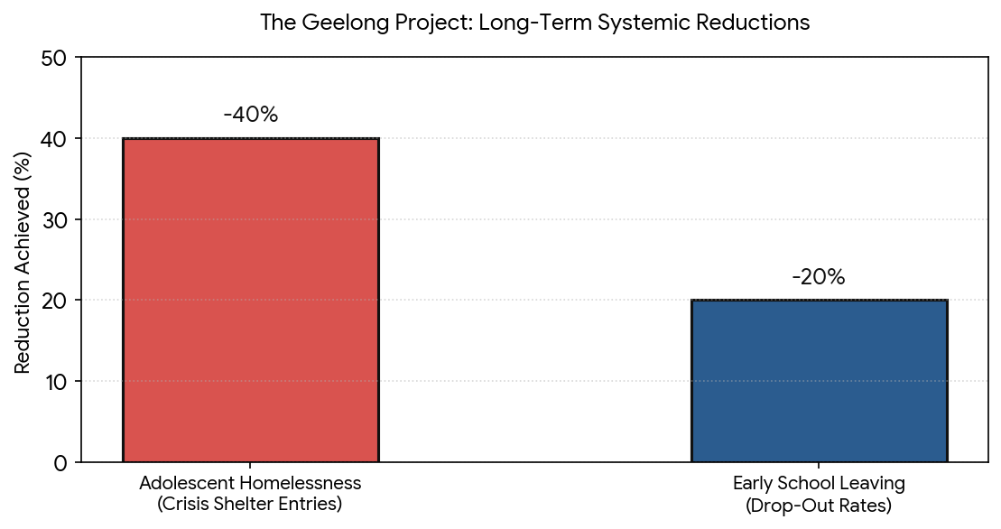
Success Models
Upstream Prevention the Geelong Project
Three core pillars of the model
Universal screening
Whole family focus
Coordinated Support pool

Slide 21
Success Models
Built for Zero
Built for Zero is a rigorous, data-driven systems-change model originated in the US and piloted across the UK by the national housing charity Crisis.
The core philosophy is that homelessness is a solvable systemic failure, not an individual choice. Instead of managing the crisis through siloed organisations, Built for Zero brings local councils, health services, and charities together to coordinate a localized framework aimed at driving specific homelessness cohorts down to zero.
Current homelessness systems cannot cope with the conditions in which they now operate. Taking a cohorted approach to change Built for Zero strives to small scale test big ideas and slowly implement them if they are successful.

Slide 22
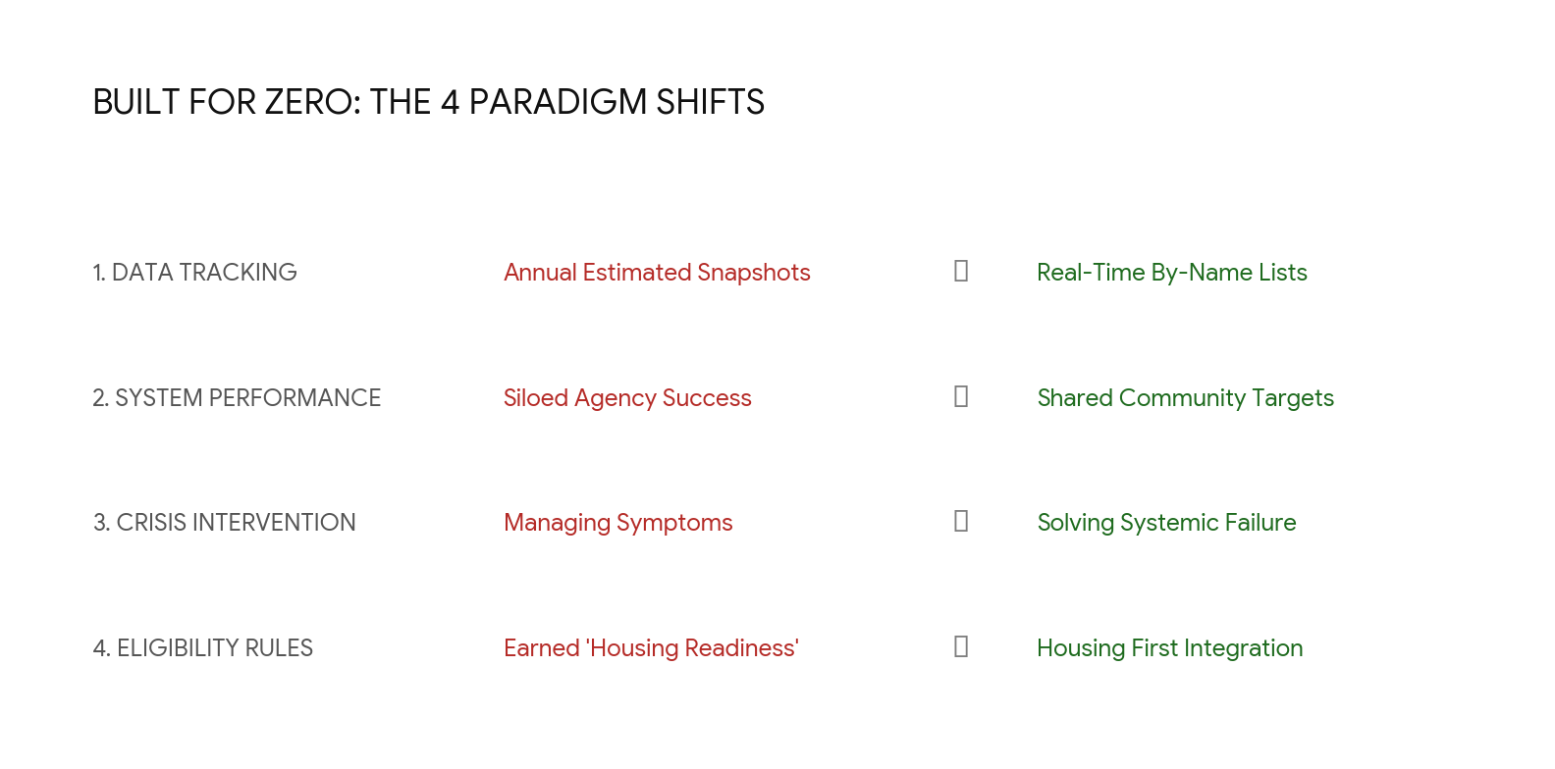
Success Models
Built for Zero

Slide 23
Success Models
Common themes
Team integration
Share aim/goal
Flexible policies
Open to change
Power sharing
Person centred

Slide 24
Turning the tide and building resilience
1. Widening the "Outflow Pipe" (Boosting Social Housing Stock)
As demonstrated by the MHCLG housing deficit data, the UK currently sells roughly two council homes for every one it replaces.
The Action: Protect existing social infrastructure by suspending or heavily restricting the Right to Buy scheme, as seen in Scotland and Wales.
The Target: Implement long-term, multi-year funding injections to build a minimum of 90,000 social rent homes annually, widening the bottom exit of the funnel.

Slide 25
Turning the tide and building resilience
Permanently unfreezing the Local Housing Allowance (LHA)
The ongoing freeze on LHA benefit rates creates an out-of-pocket shortfall of nearly £1,500 per year for low-income tenants, driving them directly into eviction.
The Action: Pass legislation to permanently tie LHA rates to the true 30th percentile of local market rents, updating the baseline automatically every financial year.
The Target: Re-stabilize vulnerable private renters, ensuring that a single benefit claimant can afford to rent at least 30% of the active, local properties on the market.

Slide 26
Turning the tide and building resilience
National Expansion of Housing First
The Demand: Crisis is campaigning for the government's long-term housing strategy to legislate and fully fund a national rollout of the Housing First model.
The Rationale: While regional pilots have proven a 92% tenancy sustainment rate among chronic rough sleepers with complex needs, the strategy currently lacks a permanent, nationwide expansion framework

Slide 27
Turning the tide and building resilience
Binding Social Housing Construction Guarantees
The Demand: Crisis demands a statutory guarantee that a significant portion of the government’s housebuilding targets are legally ring-fenced as social rent homes allocated to those in the absolute greatest need.
The Rationale: Although the state has pledged to invest in affordable housing delivery, the current strategy fails to specify the exact volume of homes that will be made available for rent to individuals trapped in temporary hostels and B&Bs.

Slide 28
Turning the tide and building resilience
Direct Funding for the Prevention Duty
The Demand: The organization demands long-term, multi-year funding guarantees for local authorities to satisfy their statutory duties under the Homelessness Reduction Act.
The Rationale: Frontline councils require financial stability over a multi-year horizon to invest in proactive early-stage intervention structures—such as family mediation, private rental deposit access schemes, and youth advice clinics—rather than reacting only when a household hits absolute street-level crisis

Slide 29
Turning the tide and building resilience
Institutional Discharge Safeguards
The Demand: Crisis wants a robust, legally binding duty across all relevant public bodies to prevent individuals from being discharged from public institutions into homelessness.
The Rationale: Over 34,000 households were released straight onto the streets from prisons, hospitals, and care institutions. Crisis demands cross-government accountability rules to guarantee that no individual transitions from state custody without a safe, verified home placement

Slide 30
A brigher future?
Homelessness is not an unchangeable trait of modern society.
It is the visible symptom of a fragmented safety net and frozen infrastructure. The international and UK success models we have examined prove that when we align behind a single, shared goal, share data in real time, and empower local authorities with flexible spending autonomy, the tide turns.
We have the data, we have the framework, and we know what works. Our final task is to build the collective political and operational will to scale these strategic interventions nationwide—transforming our housing network into a system where homelessness is brief, rare, and non-recurring.

