Slide 1


VOICE
OF
HOPE
Notes:
Hi hello
Introduce: Lucy & Bee
Today we are going to introduce you to Voice of Hope:
- our long-term campaigning and influencing project
Designed to shift:
- Public understanding
- Policy
- Practice

Slide 2
VOICE
OF
HOPE
A SHARED MISSION
At Hopestead, our ambition is not just to respond to homelessness, but to help end it together.
Notes:
“At Hopestead, our ambition is not just to respond to homelessness—but to help end it.”

Slide 3
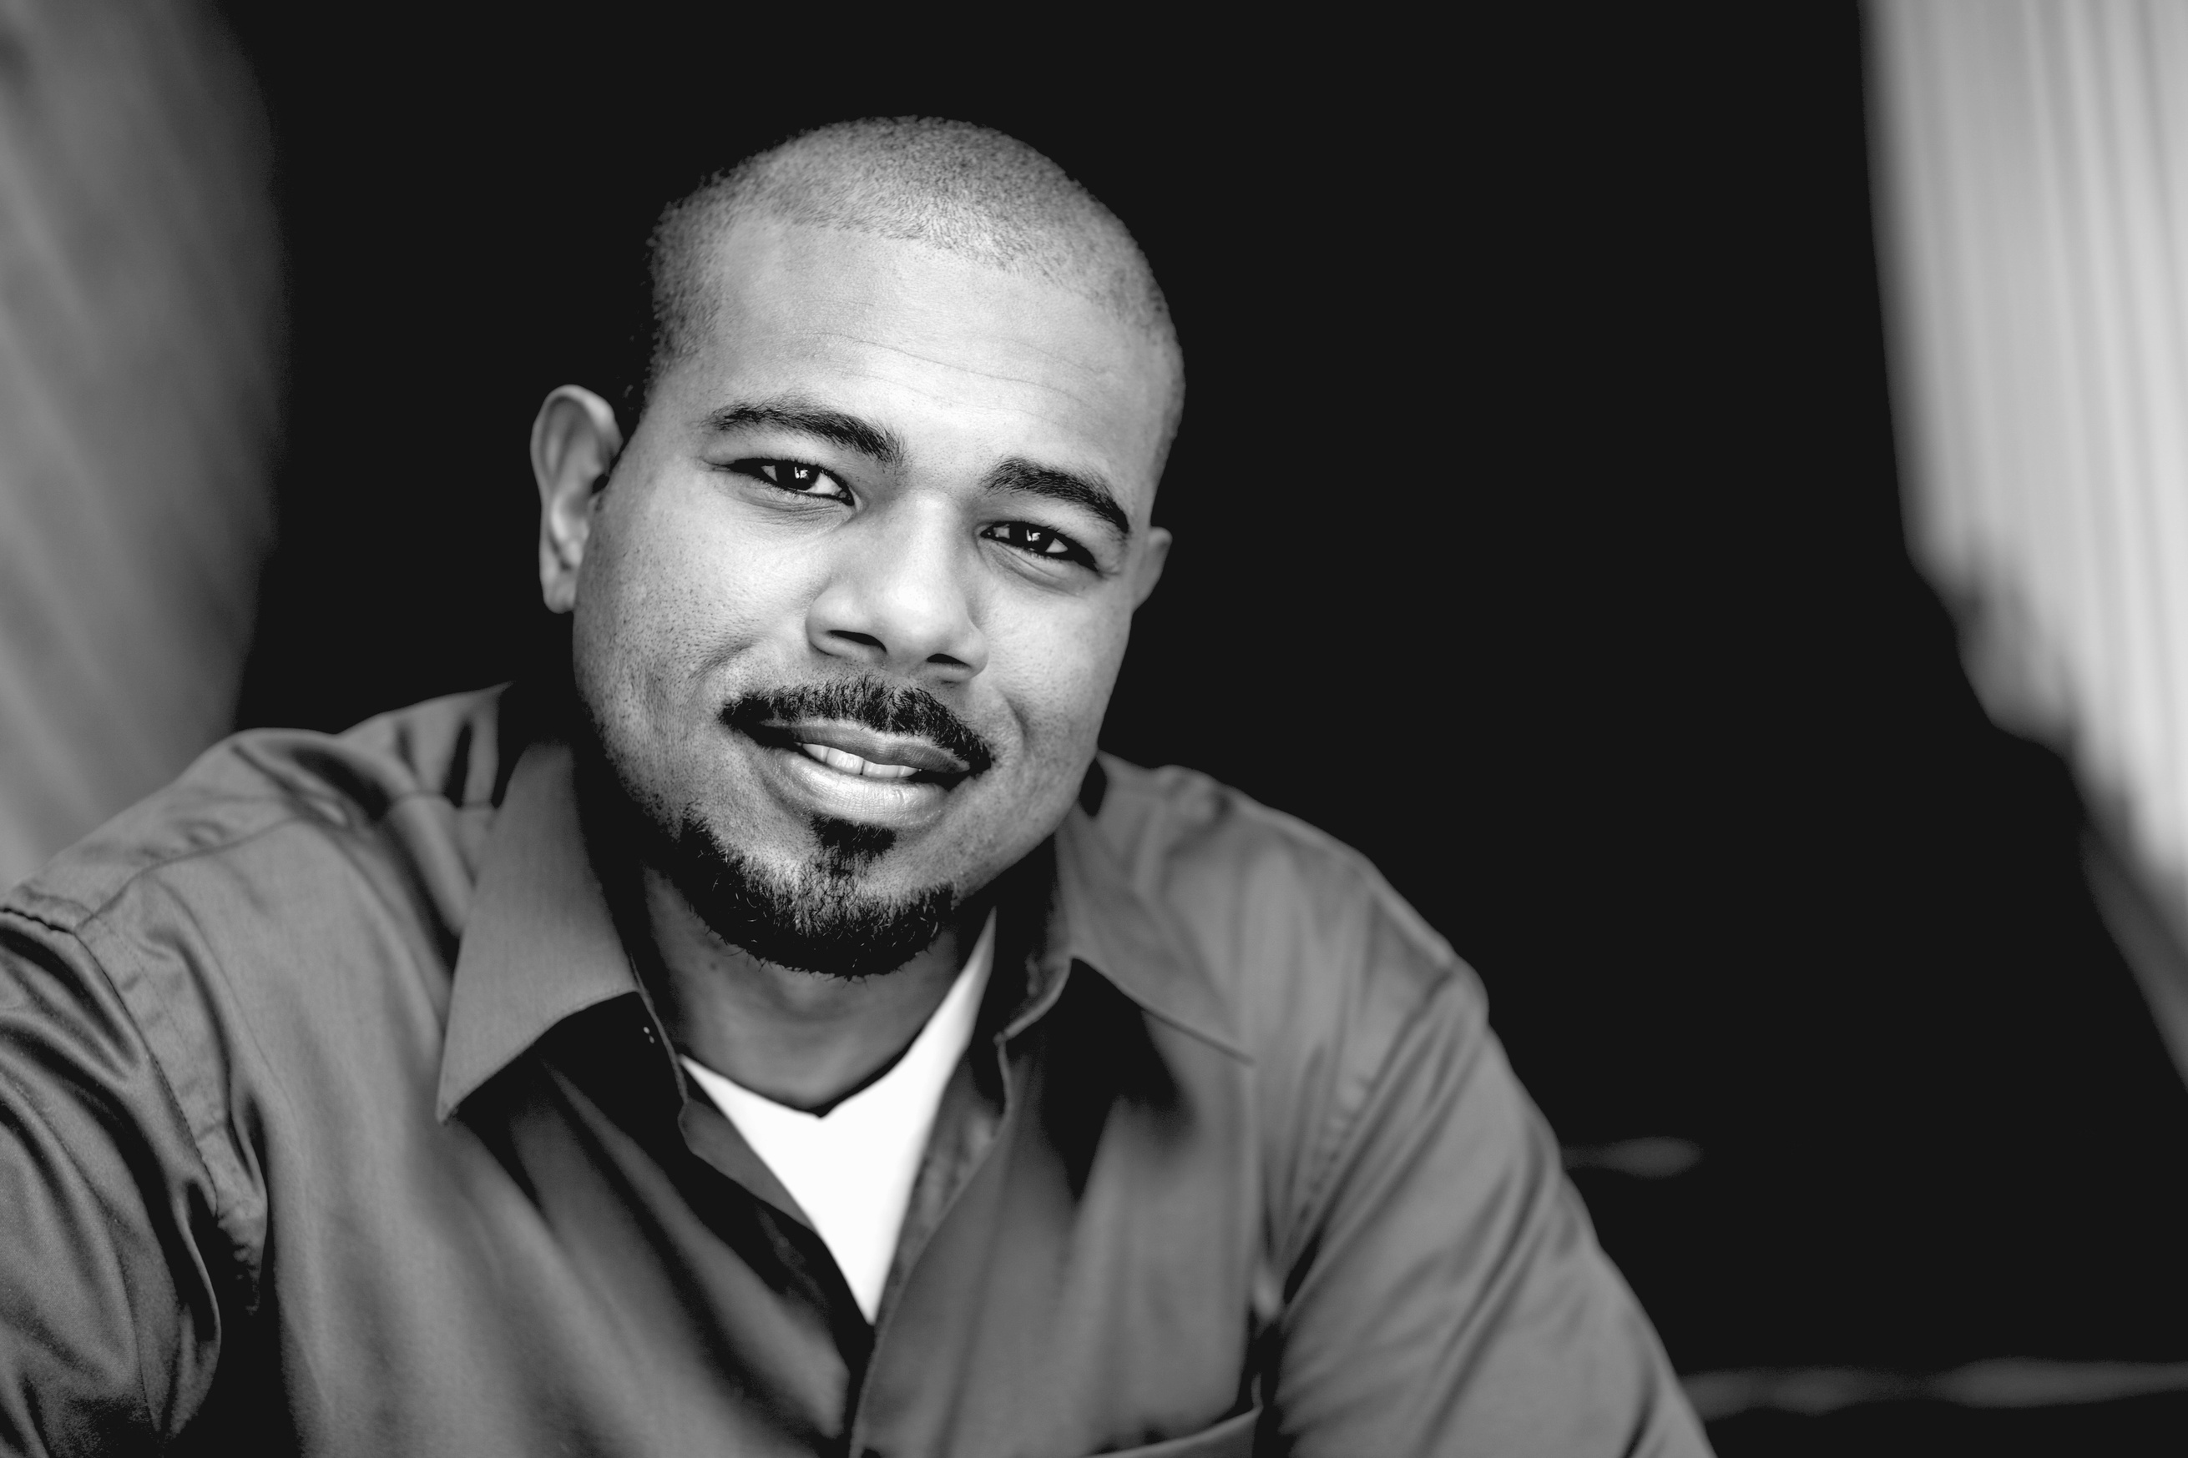
VOICE
OF
HOPE
VOICE
OF
HOPE
Raise awareness,
shift perceptions, and advocate for effective policy change grounded in lived experience and data.
Notes:
The Core Challenge: How homelessness is understood shapes how it’s solved
There is a problem there. Our solution: Voice of Hope exists to “Raise awareness, shift perceptions, and advocate for effective policy change grounded in lived experience and data”

Slide 4

VOICE
OF
HOPE
EVIDENCE
LIVED EXPERIENCE
INFLUENCE
  Commissioned research
  Data on homelessness trends
  Identifying barriers and gaps in provision
  Community Voices
  Frontline insight
  Policy engagement
  Campaigning and media
Notes:
Voice of Hope is a campaigning platform that brings together:
Evidence
• Research aka State of the Region report, The Missing Year
• Data on homelessness trends and gaps
Lived Experience
• Community Voices
• Frontline insight
Influence
• Policy engagement
• Campaigning + media
Voice of Hope connects insight, voice and influence to drive change.

Slide 5

Notes:
But what is our place?
An example is our newest campaign: The Missing Year

Slide 6
THE
MISSING
YEAR
Through our work, one insight has become particularly clear- the period immediately after someone is housed is both critical and often overlooked.
It marks the point at which homelessness is considered ‘solved’ yet we know the risk of it returning remains high.
Too often, people transition into housing without the essentials they need to make it sustainable. The very moment of moving into a home can become the moment support falls away.
This is the point at which tenancies either stabilise or begin to break down.
At Hopestead, we see that this crucial phase where long-term outcomes are shaped,
is largely invisible.
Notes:
Currently: Focus on visible crisis and emergency responses (which are needed)
Result: Success measured at the point of placement, not long-term outcomes

Slide 7
THE
MISSING
YEAR
The Missing Year isn’t the problem; it reveals the problem.
Notes:
It highlights a deeper issue, that systems are structured around short-term success
• Gaps in support
• Misaligned metrics
• Missed opportunities for prevention
“The Missing Year isn’t the problem—it reveals the problem.”
in homelessness prevention and relief

Slide 8
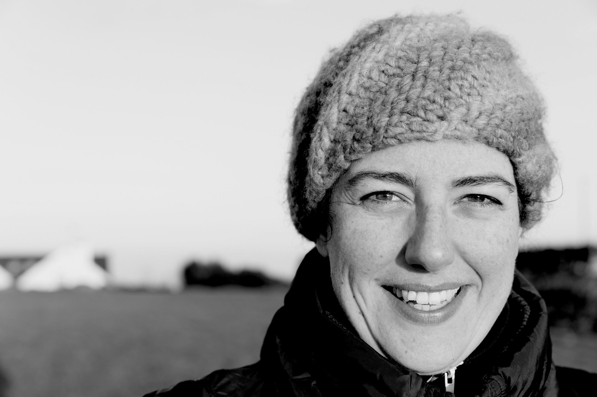
VOICE
OF
HOPE
HOW DO WE
CREATE CHANGE
TOGETHER?

Slide 9
VOICE
OF
HOPE
CHANGE THE
NARRATIVE
BUILD
UNDERSTANDING
INFLUENCE
SYSTEMS
CHANGE
Notes:
to simplify our TOC
1. Build understanding (Insight & Evidence)
• Research & data collection
• Lived experience
• Identify gaps like the Missing Year
2. Change the narrative (Public engagement)
• Campaigns, storytelling, media
• Shift how homelessness is seen and discussed
3. Influence systems (Policy & practice)
• Work with local authorities, partners, policymakers
• Embed better definitions of success

Slide 10
VOICE
OF
HOPE
PARTNERSHIP
SHAPE INSIGHT:
SHARE DATA,
EXPERIENCE
AND LEARNING
CO-CREATE
WORKSHOPS,
ROUNDTABLES
AND STRATEGY
DEVELOPMENT
DRIVE CHANGE
EMBED NEW APPROACHES LOCALLY AND NATIONALLY
Notes:
This only works if we do it together. Voice of Hope is designed to work with the sector.
Partners help to:
• Shape insight
o Share data, experience, learning
• Co-create solutions
o Workshops, roundtables, strategy development
• Drive change
o Embed new approaches locally and nationally
This is about shared ownership of outcomes...

Slide 11
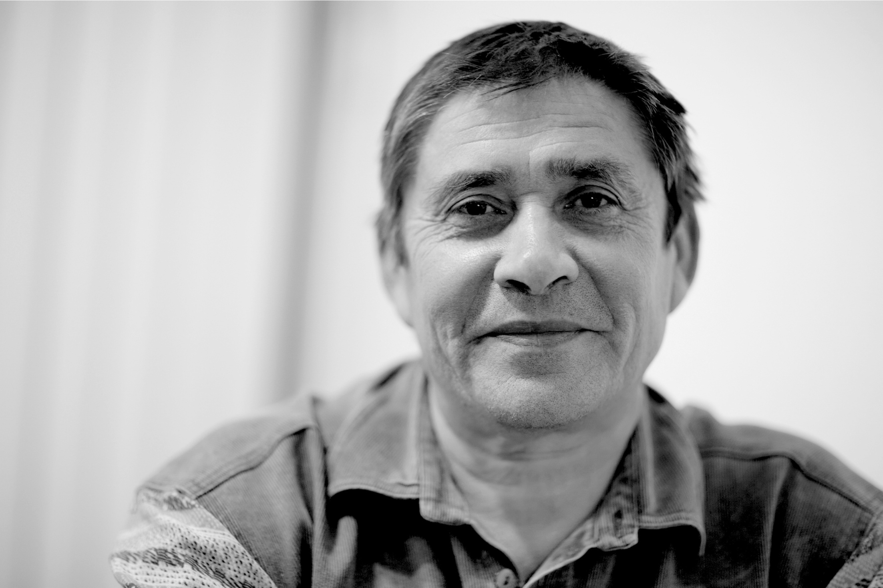
VOICE
OF
HOPE
LIVED EXPERIENCE AT THE CENTRE
Notes:
Lived experience is crucial - we can't do our work without it. LV will
• Shape narrative
• Inform research
• Influence solutions
But more than that...
Voice of Hope is not about speaking for people—it’s about creating space for people to be heard, amplifying voices, getting into the room where it happens and supporting them to lead change.

Slide 12
VOICE
OF
HOPE
WHAT DOES SUCCESS LOOK LIKE?
BETTER UNDERSTANDING OF HOMELESSNESS
POLICY SHAPED BY EVIDENCE AND LIVED EXPERIENCE
GREATER FOCUS ON PREVENTION, SUSTAINMENT, LONG-TERM STABILITY

Slide 13
VOICE
OF
HOPE
JOIN US IN CHANGING THE STORY...
AND THE SYSTEM
The Missing Year is just one example of what we’re uncovering through Voice of Hope.
But the bigger opportunity is this: to work together to redefine
success, reshape systems, and ultimately end homelessness.
Notes:
We want YOU to join us - change the story AND the system

Slide 14

JOIN US IN CHANGING THE STORY
AND THE SYSTEM
VOICE
OF
HOPE
ENGAGE
CONTRIBUTE
CREATE
LEAD
SHARE AND
SUPPORT
OUR WORK
FEED INTO OUR
RESEARCH
CO-PRODUCE
SOLUTIONS AND
RECOMMENDATIONS
PILOT APPROACHES, EMBEDING
COMMUNITY-LED SOLUTIONS
Notes:
What are our asks?
• Engage
o share and support our work
• Contribute
o Share insight, data, and learning
o Feed into ‘State of the Region’ work
o Bring frontline and lived experience voices into Community Voices
• Create with us
o Take part in workshops and roundtables
o Co-produce recommendations
o Test ideas grounded in lived experience
• Lead with us
o LAs:
▪ Explore how success is measured locally
▪ Beyond placement → tenancy sustainment
▪ Use insight (like the Missing Year) to inform strategy
▪ Engage in policy conversations and pilot approaches
o VCSE/other orgs:
▪ Share and test what works in sustainment and prevention
▪ Embed lived experience in design and delivery
▪ Help amplify community-led solutions

Slide 15

Notes:
Hopestead: because everyone deserves a place to call home
Thank you...

