Slide 1


Lesley Burdett
Executive Strategic Lead Shelter Norfolk
Chair Norfolk Homelessness Solutions Forum

Slide 2

Brief history of the NSHP/NHSF
No Homelessness In Norfolk - Resetting the system - a partnership approach - report launched 2022
A detailed overview of rough sleeping, Covid impacts, Everyone In & the case for investing in relieving and preventing homelessness
Norfolk Strategic Housing Partnership (NSHP) Membership proposed; made up of Local Authorities, Children and NCC Young People and Adult Services, CCG, Public Health, Police and Registered Providers.
The Partnership would report directly into the Norfolk Chief Executives Group
Multi agency consultation took place to develop a county wide Homelessness Prevention Strategy (2022 to 2025) and the Norfolk Homelessness Solutions Forum (NHSF) was launched (chaired by Shelter)

Slide 3
Consensus to support the continuation of a revised NHSF
Priorities agreed were
  Re-establish a county wide homelessness solutions forum
  Update the Terms of Reference for the forum
  Facilitate a ‘community of practice’ for frontline organisations & support a multi-agency/solution focused approach
  Provide support and guidance to organisations who plan to adopt the Norfolk homelessness charter
  The forum can agree key challenges and potential solutions to be fed back to decision makers via the Living and Working Conditions Leadership Group

Slide 4
Activities
2025-26
Rebranding in collaboration with NCAN
Supporting Sector Engagement with Homelessness Health Needs Audit
Scoping membership of Homelessness Forum Leadership team
RRA training offer to NHSF members
Securing escalation route for homelessness issues through ICS structures
Seeking funding to resource Solutions Forum activity

Slide 5
Funding The Forum

Slide 6


Slide 7

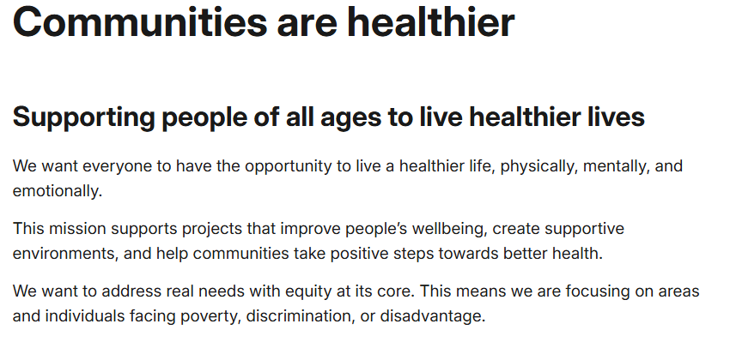

Slide 8
Project Aims
What we want to do
What are the outcomes we want to achieve?
To support people to have healthier lives by improving the support they receive when they are experiencing homelessness and preventing people from becoming homeless when they have a housing issue
Opportunities for people who are homeless or at risk of homelessness to be proactively engaged and supported to inform practice, policy, service delivery and strategies
VCSE partners role, as advocates and trusted agencies of those with lived experience, will facilitate co-production and bridge the barriers to the statutory sector
Improved equity of access to cross sector services and accommodation, thus improved outcomes, and experience for those experiencing homelessness.

Slide 9

Linking the project to the Charter

Slide 10
Themes 2026
Follow up and agree next steps after Homelessness Health Needs Audit 2025
  WHY? (MHCLG - A National Plan to End Homelessness)
    Strengthen how housing, social care, and safeguarding services work together, especially for people with complex needs.
    Support councils to deliver flexible, person-centred support and co-ordinated specialist services to help with chronic co-occurring needs for people experiencing multiple disadvantage.
      Potential for projects in a post changing futures world?
  Providing evidence to ASC and ICS of need for additional wrap round support services and funding for the most vulnerable cohort of homeless people
Focus on improving experience of young people leaving the care system
  WHY? (MHCLG - A National Plan to End Homelessness)
    Prevent the homelessness system from being used as a pathway to house care leavers following the end of a Looked After Child Placement.
    Provide early support and resilience-building to help young people break the cycle of homelessness, find a safe and stable home and develop the skills to live independently.
  Opportunity to coproduce improved pathways with Break's Housing Project Working Group

Slide 11
Next Steps
Staff Recruitment – closing date 27th May
Solutions Forum Steering Group kick off meeting – by end June
Project Coordinator work plan development
Lived Experience Group recruitment
Developing action focused theories of change for leaving care and chronic co-occurring needs for people experiencing multiple disadvantage projects

Slide 12

Any questions or comments
lesleyb@shelter.org.uk

Slide 13
Thank you

